Slide 1
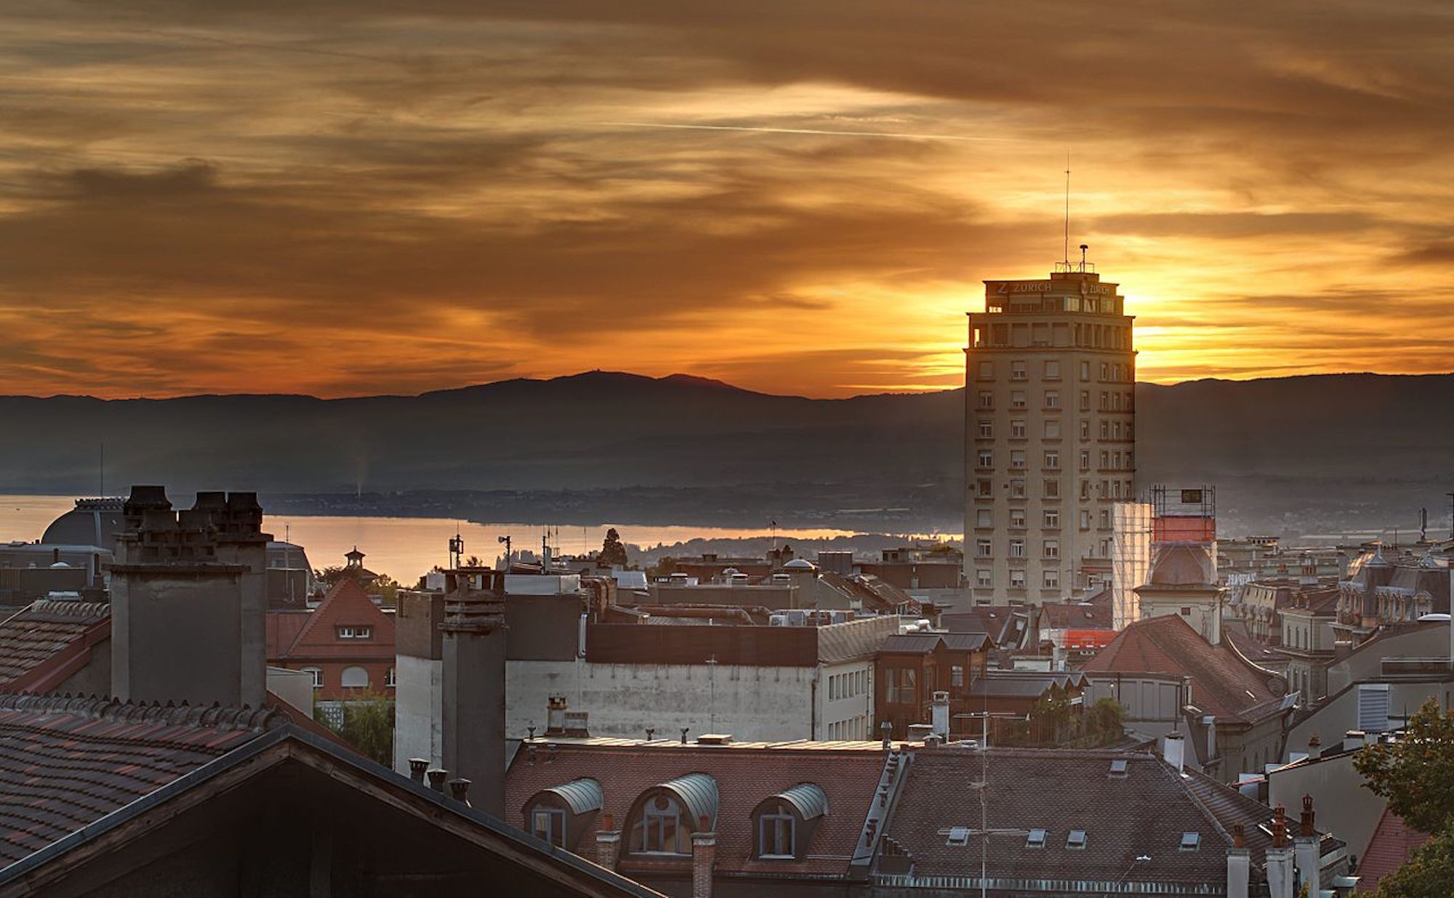
EPFL - Laboratoire d’Economie Urbaine et de l’Environnement
THE BEST LOCATION FOR YOU TO LIVE
Neypatraiky Y., Rimbot T., Habert P.

Slide 2



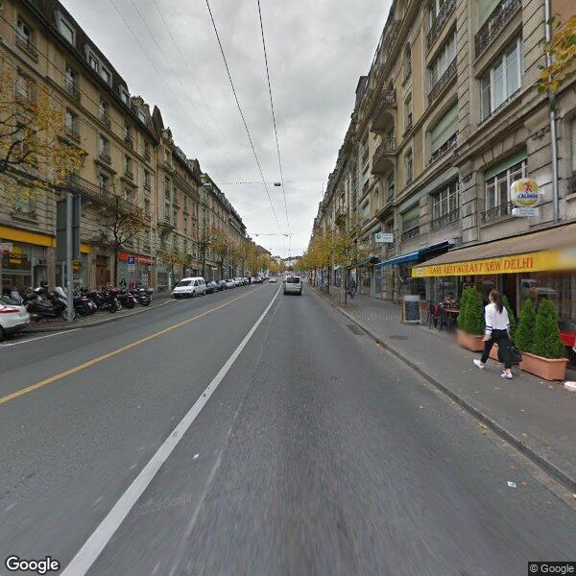
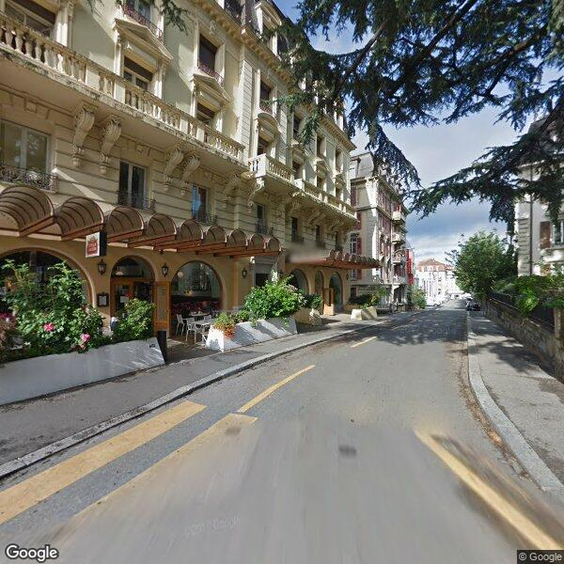



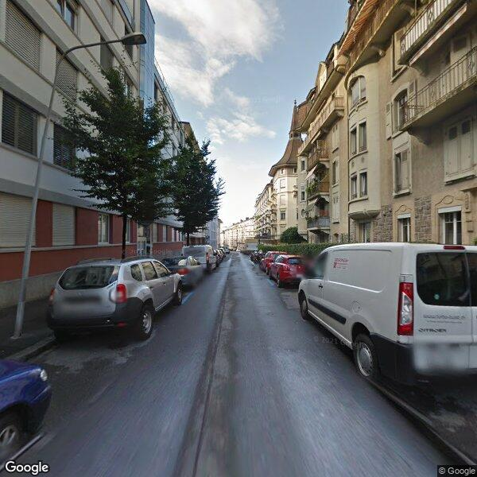

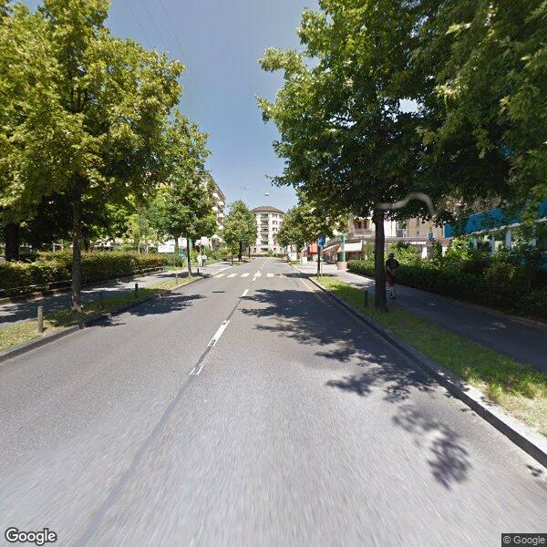

DATA
Google Street View
Survey Battle Game

Slide 3


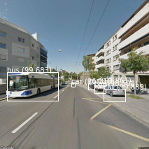
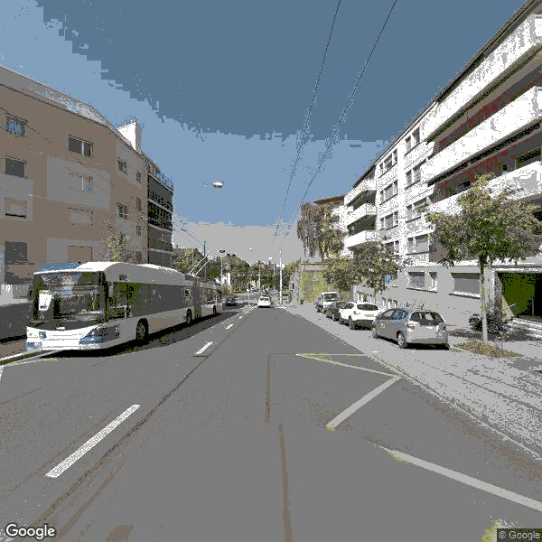


PREPROCESSING
Object Recognition
Image Segmentation

Slide 4



MODELS
Regression Models
Classification Models
25
78
22
74
74
74
71
67
LIN REG W/ LASSO
50
SUPPORT VECTOR REG
LIN OLS W/ LASSO
RANDOM FOREST
SVM
DECISION TREE
KNN
LOGIT
BASELINE
BASELINE
MSE decrease [%]
AUC of ROC curve [%]

Slide 5

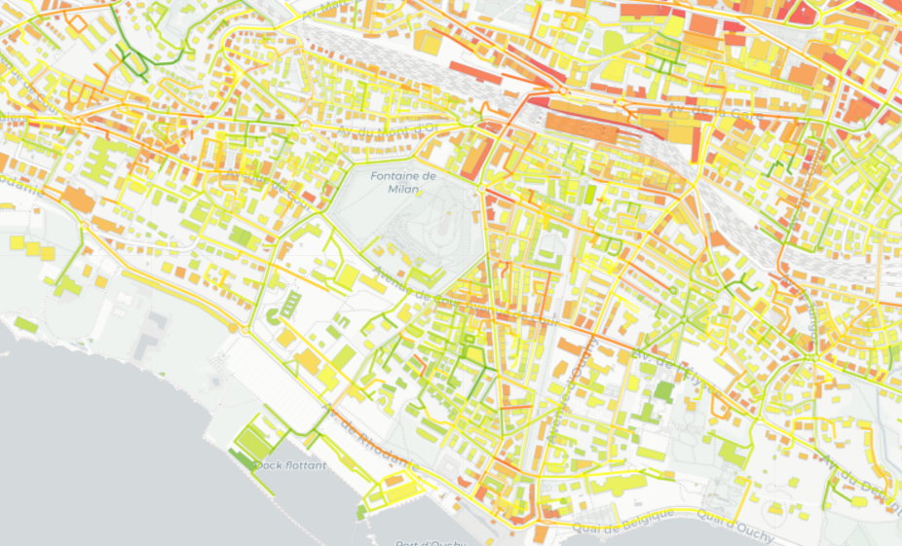







USER INTERFACE
Predicted Appeal
Environmental Data
Air pollution
Noise
Sunlight
Addable Data

Slide 6




DEPLOYMENT
Potential Clients
Buildings owners: investment companies, banks, insurance companies
Real Estate agencies
House seekers

